Slide 1

WIPRO NGA Program – Embedded Testing
Capstone Project Presentation – 17th February to 25th March 2025
Project Title Here – Demowebshop-Tricentis Capstone Project
Presented by – Sundarrajan S
www.rpsconsulting.in

Slide 2

INTRODUCTION
This Capstone Project aims to design a proper comprehensive automated test suite to test the core functionalities of an e-commerce application using Selenium WebDriver. This framework integrates BDD and the POM approach with elements to make scripts readable, reusable, and maintainable with ease.
To improve scalability and efficiency, this project is structured using Maven for dependency management and build automation. It also supports cross-browser testing across Chrome, Firefox, and Edge to ensure consistency in user experience in multiple environments.
To configure using Jenkins then automate the testing process by configure the GitHub repository link to the Jenkins, after using build we want to build the project then it will give the build success output.
2025 - RPS Consulting all rights reserved

Slide 3
OBJECTIVES :
Develop an Automated Test Framework
Cross-Browser Compatibility
Implement Data-Driven Concept
Validate Key Functionalities
Generate Extent report
TestNG file Test Case Execution
GitHub Repository
Jenkins
2025 - RPS Consulting all rights reserved

Slide 4
ABOUT THE APPLICATION :
The Demowebshop-Tricentis is a demo e-commerce site utilized mostly for testing and demonstration. It contains a list of products, such as electronics, books, and apparel, that mimic an actual online shopping experience. The site is easy to navigate with categories like "Home," "Books," "Electronics," and "Apparel." Products can be browsed, detailed descriptions viewed, and items placed in the shopping cart and checked out. Moreover, the website provides user account functionality like registration and sign-in. Overall, it is a perfect website to practice automated testing and get to know e-commerce workflows without engaging in actual transactions.
2025 - RPS Consulting all rights reserved

Slide 5
TESTING PROCESS :
1. Requirement Analysis
Understand and analyze the functional requirements of Demowebshop (Search, Filter, Cart, Login, etc.).
Identify test scenarios for key user flows.
2. Test Framework Setup
Tools Used: Selenium WebDriver, Maven, TestNG/JUnit, Cucumber (BDD).
Framework Design: Page Object Model (POM) for modular and reusable code.
Cross-Browser Setup: Configure Chrome, Firefox, and Edge browsers.
2025 - RPS Consulting all rights reserved

Slide 6
TESTING PROCESS :
3. Test Case Development
Write BDD feature files (Gherkin syntax) for each functionality.
Implement step definitions and corresponding page actions.
Include validations, waits (WebDriverWait), and reporting (ExtentReports).
4. Test Execution
Run automated test scripts across multiple browsers.
Perform Regression, Functional, and UI Testing.
Generate test reports and logs for analysis.
2025 - RPS Consulting all rights reserved

Slide 7
TESTING PROCESS :
5. Jenkins Integration
Integrate with Jenkins/GitLab for continuous test execution.
Trigger automated tests on code updates or scheduled intervals.
Monitor build status and test results in Jenkins.
6. Defect Reporting & Maintenance
Log bugs for failed scenarios.
Update scripts based on application changes.
Maintain codebase for scalability and future enhancements.
2025 - RPS Consulting all rights reserved

Slide 8
MAJOR FUNCTIONALITIES :
1. User registration And Login
2. Forgot password
3. Home Page Validation
4. Search Bar Functionality
5. Product Filtering
6. Product Validation
7. Add to Shopping Cart and WishList
8. Updating and Removing the Products
9. Checkout and Book Purchase
10. Jenkins Execution
2025 - RPS Consulting all rights reserved

Slide 9
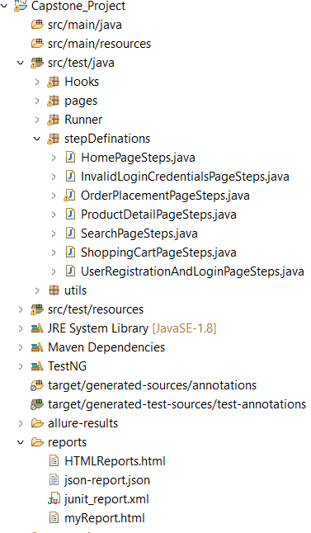
PROJECT STRUCTURE :
2025 - RPS Consulting all rights reserved

Slide 10
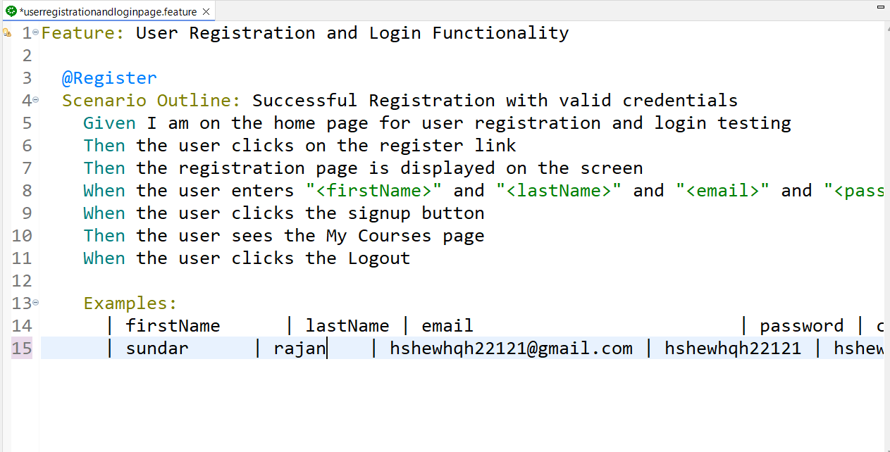
SCREENSHOTS OF TEST CASES :
2025 - RPS Consulting all rights reserved

Slide 11
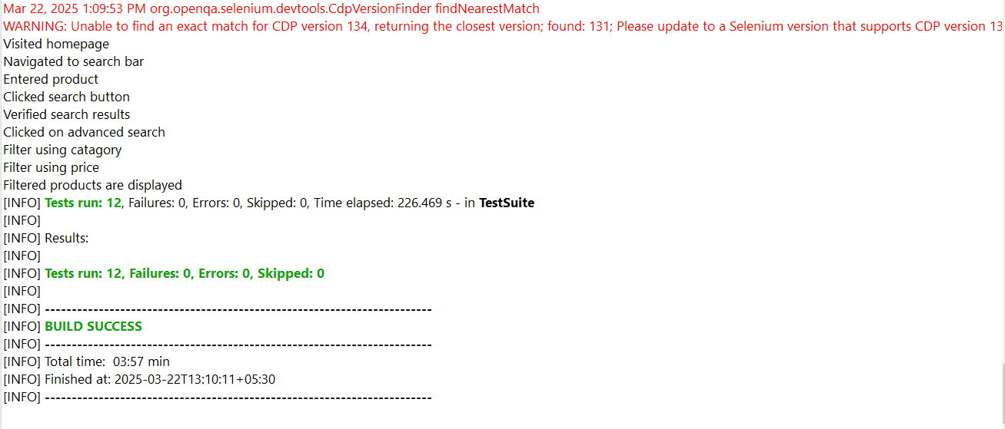
SCREENSHOTS OF TEST CASES :
2025 - RPS Consulting all rights reserved

Slide 12
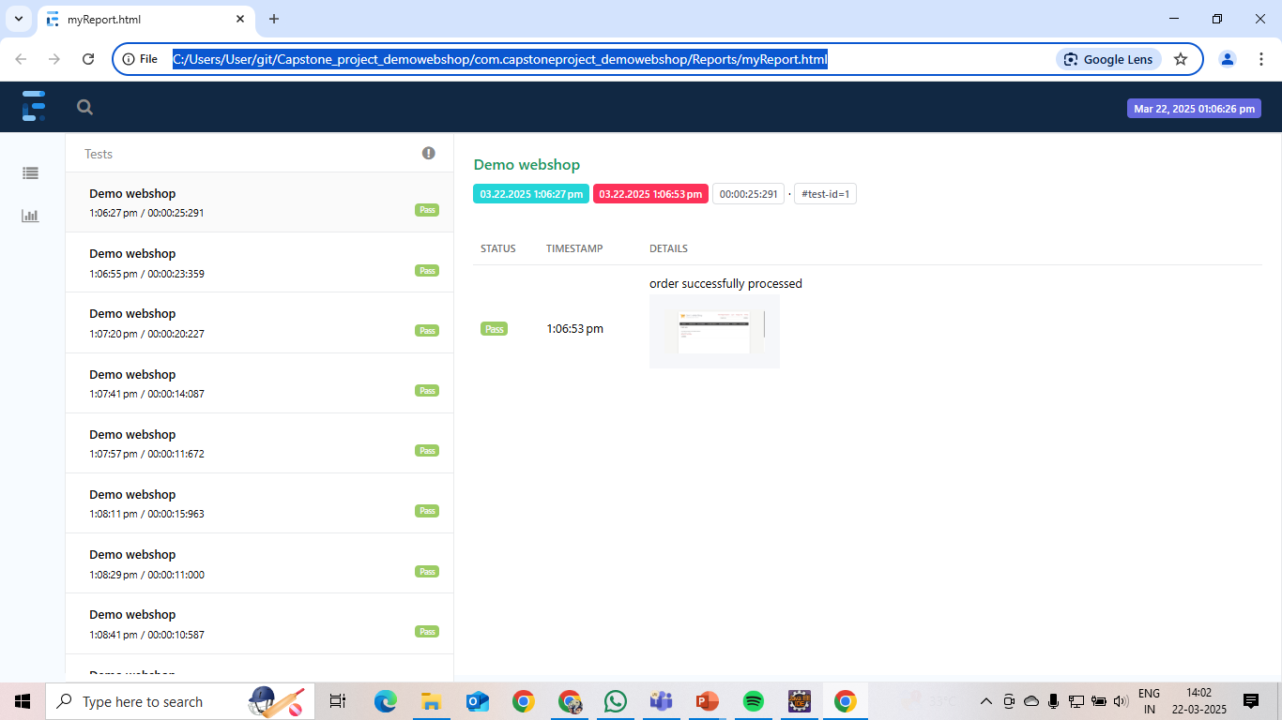
SCREENSHOTS OF TEST CASES :
2025 - RPS Consulting all rights reserved

Slide 13
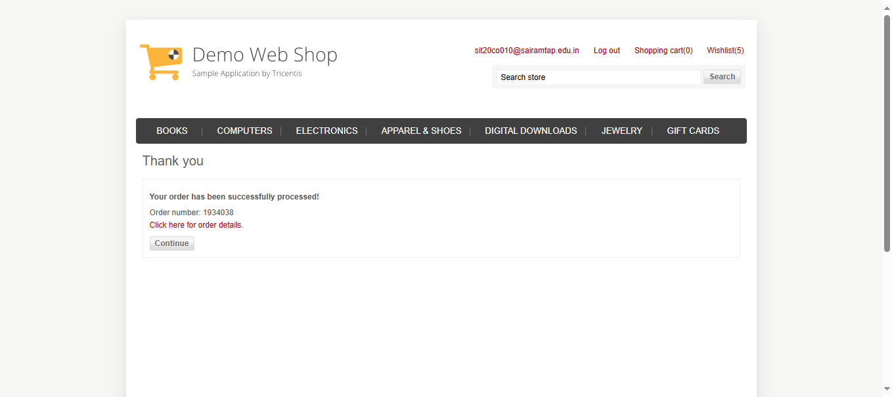
SCREENSHOTS OF TEST CASES :
2025 - RPS Consulting all rights reserved

Slide 14
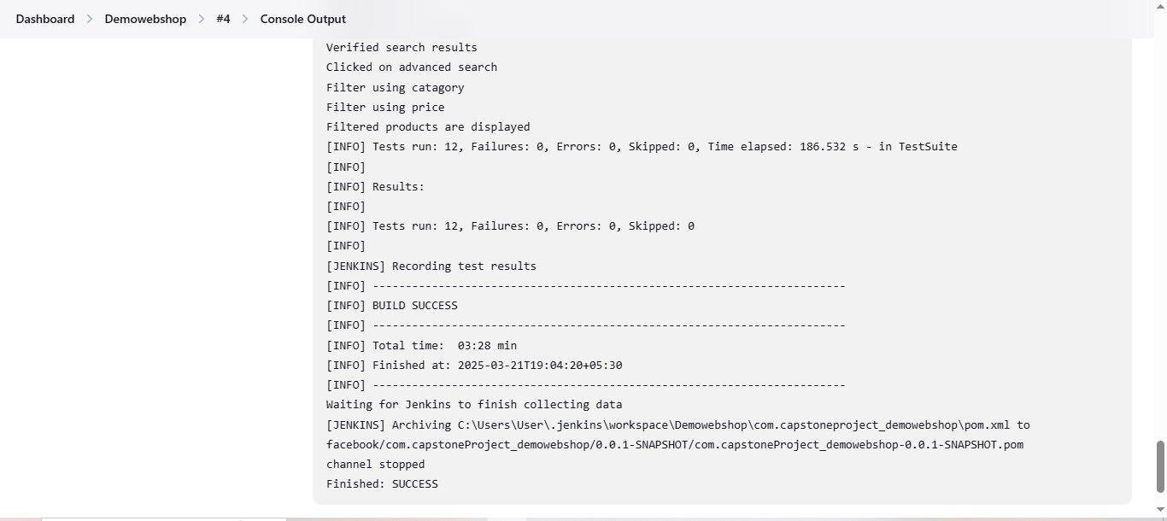
SCREENSHOTS OF TEST CASES :
2025 - RPS Consulting all rights reserved

Slide 15
CONCLUSION :
The Demowebshop-Tricentis Automation Testing project efficiently verifies all major functionalities of the application, providing a smooth user experience. Through Selenium integration with BDD and POM frameworks, the testing process is optimized to be efficient, scalable, and maintainable. Cross-browser testing ensures compatibility with leading browsers, and Jenkins integration provides continuous quality assurance. In all, this automated test suite improves reliability, minimizes manual effort, and enables quicker, error-free releases.
2025 - RPS Consulting all rights reserved

